Slide 1
Linear Modeling for GWAS analysis
Jeff (Guangjian) Du
Computational Biology and Bioinformatics
Department of Biostatistics and Bioinformatics
Duke University
January 20, 2017
Notes:
Good afternoon everyone, thanks for coming to my 2nd pre prelim presentation, and thanks very much for your support.

Slide 2
Overview
Motivation and Objectives
Projects and Aims:
Aim #1, Testing for Loss of Homozygosity/Compound Heterozygosity
Aim #2, Admixtrure Mapping SNP Data to Evaluate Genetic Susceptibility to S. aures
Aim #3, Extension of recessive models---
Future Work
Notes:
Motivation, all my projects are GWAS related, I focus on recessive models and SNP data.
Today I am going to briefly go over my projects, The first project is about Loss of Homozygosity, which I presented last September, last semester I added Fisher Information and Monte Carlo integration.
The second project is about admixture Mapping population SNP data to evaluate genetic susceptibility, I have been working on this project last semester, it a joint project between Dr. Allen and DCRI.
Also I would introduce my third project, some ideas identified with Dr. Allen, my future work.

Slide 3
Aim #1
Testing for Loss of Homozygosity Compound Heterozygosity
Notes:
The first project I worked on is Testing for Loss of Homozygosity and compound heterozygosity.
I presented this project last September.

Slide 4
Testing Loss of Homozygosity Compound Heterozygosity
Goal
To highlight genes intolerant to having both gene copies impacted
Motivation
RVIS and TTN gene
Approach
Data frame with ExAC dataset, then score test with ALS dataset
Challenges
Computational intensity, Genetic variety, data limitation.
Notes:
Our goal: To develop a method that highlights genes that are intolerant to having both gene copies impacted by Loss-of-Function, Stop-gain, deleterious alleles.
A lot of work has been done on Residual Variation Intolerance Score (RVIS) a gene score based module to help in the interpretation of human sequence data.
It has proved very useful in interpreting de-novo mutations in patient genomes.
Limitations 1. RVIS could not predict inherited variation for two copies of genes inherited from two parents.
Limitations 2. Some genes could tolerate a lot of Loss-of-Function/Stop-Gain alleles just fine, like TTN;
Our approach: Using population data to develop a score test based on shift in homozygosity from expected gene, if gene copies were randomly sampled.

Slide 5
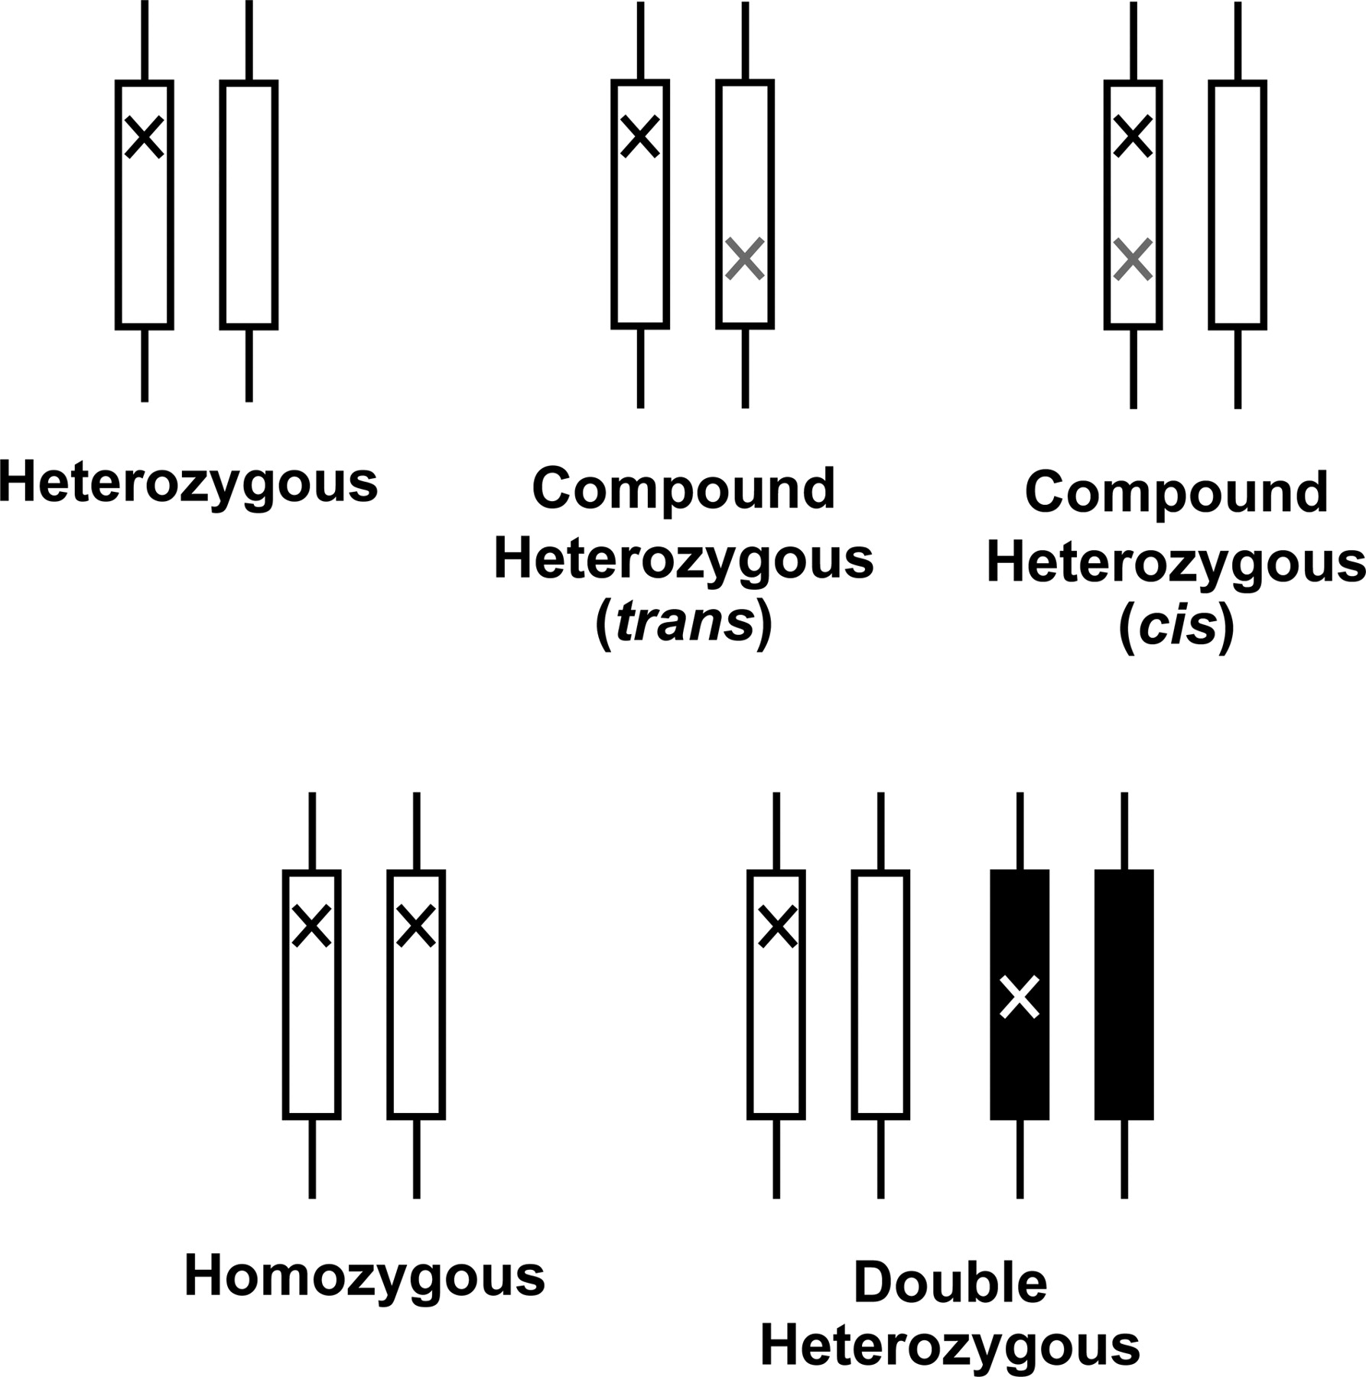
Homozygous and Compound Heterozygous (trans/cis)
Notes:
A loss of function allele could hit any copy of a gene randomly, when multi alleles happened on genes, we could get several categories as shown here.

Slide 6
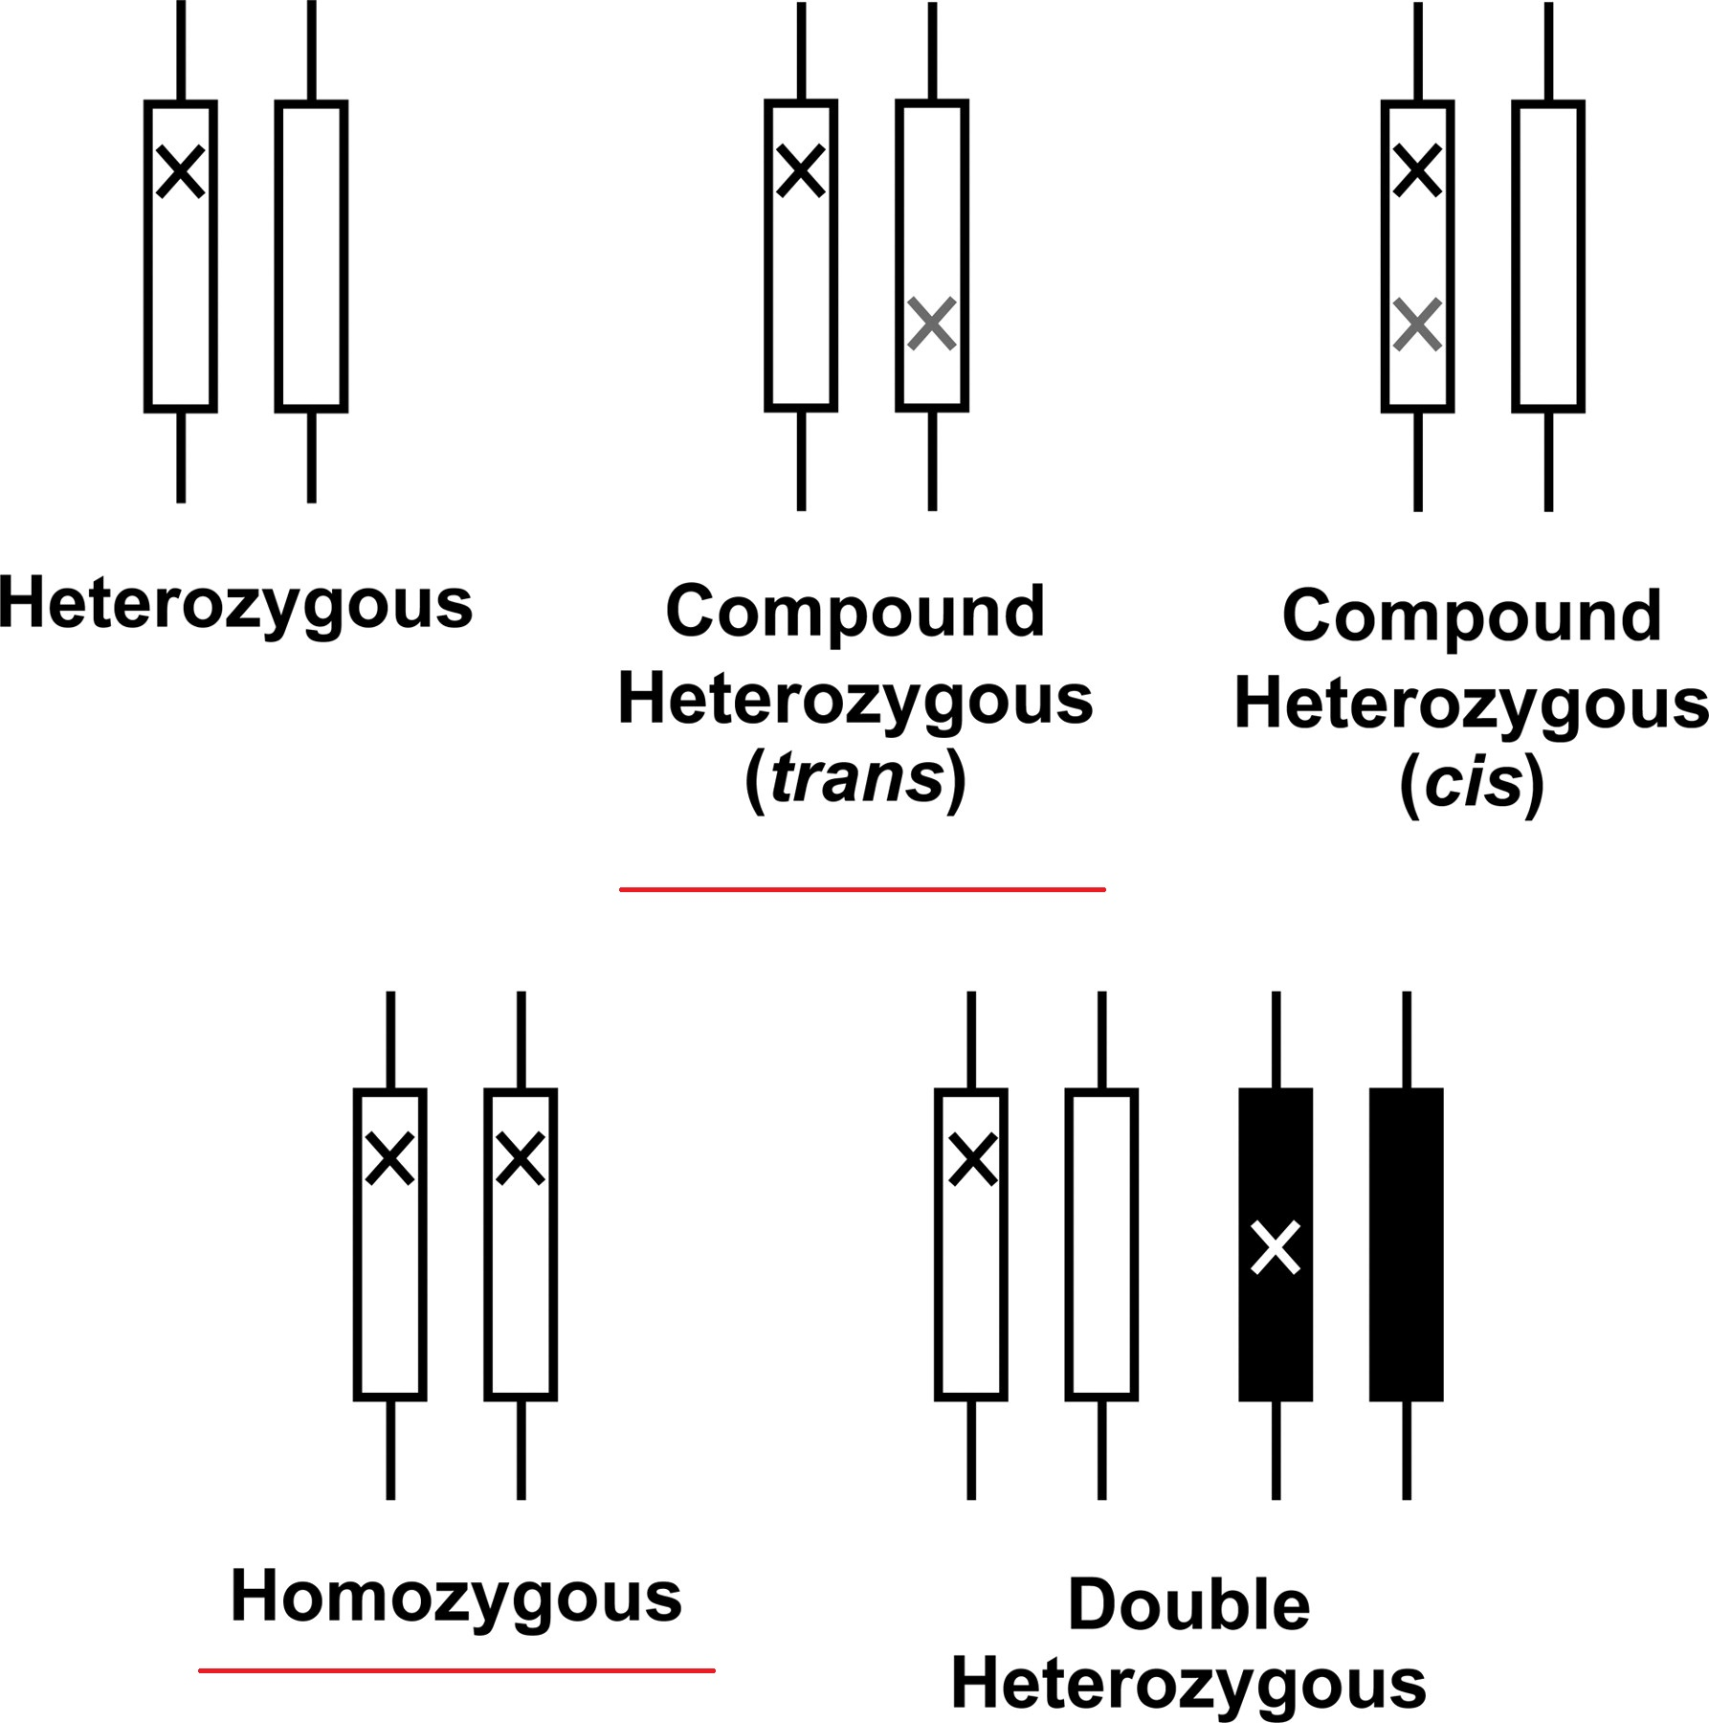
Homozygous and Compound Heterozygous (trans/cis)
Notes:
A loss of function allele could hit any copy of a gene randomly, when multi alleles happened on genes, we could get several categories as show here.
Both Homozygous and Compound Heterozygous (trans) would yield LoF gene products for recessive genotypes:
In the past decades, about 20,000 genes have been well studied, some of these genes have hundreds of mutations.
But when checking across these databases, we could barely see any homozygotes, so we have our motivation:
Is there a certain pattern of deficit of homozygous?

Slide 7
Model Theory, Score Test
How to quantify homozygous or/and compound heterozygous mutations in a particular genic context?
Notes:
While developing the model, we first have to quantify the homozygous and heterozygous;

Slide 8
Score Test, Model Theory
How to quantify homozygous or/and compound heterozygous mutations in a particular genic context?
Develop a framework to test the loss of homozygous, based on ExAC dataset and ALS dataset.
Notes:
While developing the model, we first have to quantify the homozygous and heterozygous;
After quantification, we develop a frame work to test the loss of homozygous, in other words, we try to compare the difference between therotical Hom/Het rate With the real hom/het rates.

Slide 9
Score Test, Model Theory
How to quantify homozygous or/and compound heterozygous mutations in a particular genic context?
Develop a framework to test the loss of homozygous, based on general AF dataset and gene copies dataset.
Develop a Score Test to verify the likelihood of homozygous departure rate for each gene.
Notes:
While developing the model, we first have to quantify the homozygous and heterozygous;
After we model quantification, we develop a frame work to test the loss of homozygous, in other words, we try to compare the difference between therotical Hom/Het rate
With the real hom/het rates.
Score test

Slide 10
Notations
Genotype
G - Multilocus genotype of qualifying (LoF/deleterious) mutations within a gene
Notes:
About our model, we use Capital letter G to represent multi-locus genotype of qualifying mutations within a gene;

Slide 11
Notations
Genotype
G – Multilocus genotype of qualifying (LoF/deleterious) mutations within a gene
Affected gene copies
X - Number of gene copies harboring a qualifying variant ( X = 0, 1, 2)
Notes:
About our model, we use Capital letter G to represent multilocus genotype of qualifying mutations within a gene;
Since each gene has two copies, the number of affected gene copies could be 0, 1, and 2. we use capital X to represent it.

Slide 12
Notations
Genotype
G - Multilocus genotype of qualifying (LoF/deleterious) mutations within a gene
Affected gene copies
X - Number of gene copies harboring a qualifying variant ( X = 0, 1, 2)
Control
C - Indicator of which individual was selected as control group
Notes:
About our model, we use Capital letter G to represent multilocus genotype of qualifying mutations within a gene;
Since each gene has two copies, the number of affected gene copies could be 0, 1, and 2. we use capital X to represent it.
The last capital C denotes whether a selected individual would be considered as a member of control group;

Slide 13
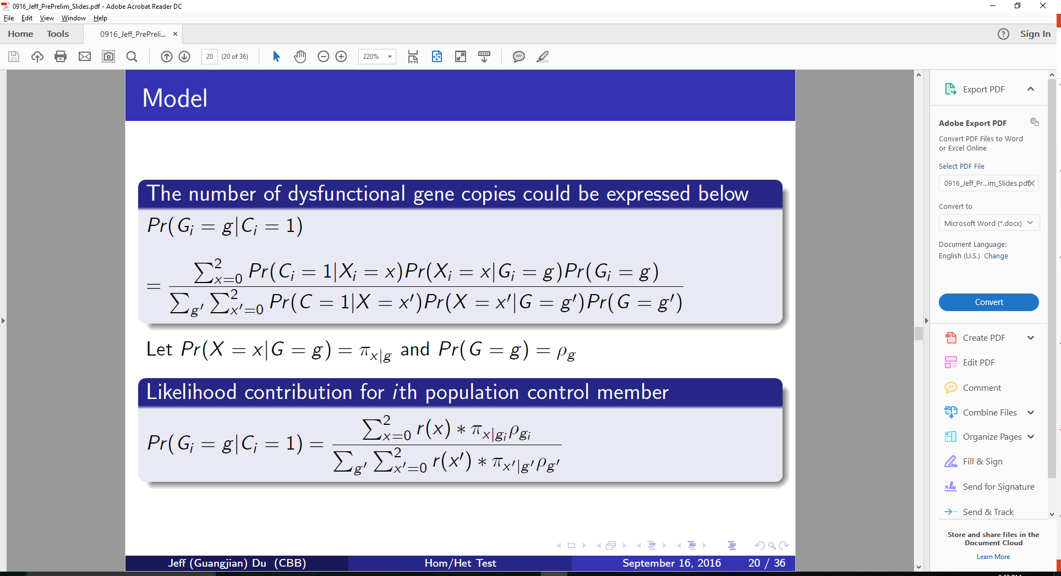
Model
The number of dysfunctional gene copies could be expressed below:
Notes:
According to total probability law and Bayesian theory, we have this equation to calculate the probability of
Let Pr(X = x | G=g) = Pai_x|g and Pr(G=g) = Rho_g

Slide 14
Model
The number of dysfunctional gene copies could be expressed below
Likelihood contribution for the ith population control member:
Notes:
Let Pr(X = x | G=g) = Pai_x|g and Pr(G=g) = Rho_g

Slide 15
Model
Likelihood contribution for the ith population control member:
Notes:
Let Pr(X = x | G=g) = Pai_x|g and Pr(G=g) = Rho_g
Taking the log of the last equation, differentiating with respect to beta, and evaluating under the null hypothesis beta = 1 gives our score: Si

Slide 16

Model
Likelihood contribution for the ith population control member:
Where $r(x)=\frac{\operatorname{Pr}\left(C=1 | X=x\right)}{Pr⁡(C=1|X=0)}$
r(0) = r(1) = 1, r(2) = β
Notes:
Let Pr(X = x | G=g) = Pai_x|g and Pr(G=g) = Rho_g
Taking the log of the last equation, differentiating with respect to beta, and evaluating under the null hypothesis beta = 1 gives our score: Si

Slide 17
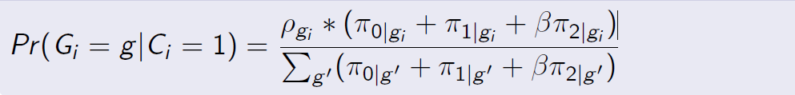

Model
Likelihood contribution for the ith population control member:
$r(x)=\frac{\operatorname{Pr}\left(C=1 | X=x\right)}{Pr⁡(C=1|X=0)}$, r(0) = r(1) = 1, r(2) = β
Notes:
Let Pr(X = x | G=g) = Pai_x|g and Pr(G=g) = Rho_g
Taking the log of the last equation, differentiating with respect to beta, and evaluating under the null hypothesis beta = 1 gives our score: Si
Assuming a recessive model, we have r(0) = r(1) = 1.
Under the null, we would expect Beta also equals to 1.
In order to carry out any of these calculations, we need to characterize Pai_2|g and Rho_g.
In our model, we assume that the variants are in approximate linkage equilibrium and any given mutation is equally likely to fall on any given haplotype.

Slide 18
Model Inferring Compound Heterozygosity
Characterizing π_{2|g}
Let n1 and n2 be the number of qualifying het/hom mutations
Notes:
Let n1 be the number of qualifying trans compound heterozygous variants
Let n2 and be the number of qualifying homozygous mutations
Given that the qualifying variants considered here will be rare in the population, it is reasonable to assume that, in the general population, any given mutation has an equal chance of landing on any haplotypic background. As a result, the variants will be in approximate linkage equilibrium.

Slide 19
Model Inferring Compound Heterozygosity
Specifying ρ_{g}
For each variant site, it follows Bernoulli distribution
For the whole gene, the mutation rate would follow Binomial distribution
Notes:
n1 and n2 be the number of qualifying heterozygous and homozygous qualifying mutations
Given that the qualifying variants considered here will be rare in the population, it is reasonable to assume that, in the general population, any given mutation has an equal chance of landing on any haplotypic background. As a result, the variants will be in approximate linkage equilibrium.

Slide 20
Null Hypothesis:
We will test H0 : β = 1 using a score test.
The alternative of interest is a decrease in homozygosity
so that H_{A} : β < 0

Slide 21
Score Test
From the score:
Notes:
The ith person’s contribution to the marginal score is Si;
This is the score equation, we use expected Pai_2|g minus observed Pai_2|g, get a vector of scores.
We tried to compare observed data with expected data.

Slide 22
Score Test
From the score:
Apply Test:
Challenge: Some genes do not have sufficient mutations. Var(Si) = 0;
Notes:
This is the score equation, we use expected Pai_2|g minus observed Pai_2|g, get a vector of scores.
Under null hypothesis, we expect T to follow an chi-square distribution asymptotically.
Here in our model, there’s only one parameter, Beta, so the test would follow Chi-square distribution, freedom 1 degree,

Slide 23
Titin (TTN) Gene
GeneCard Summary
A Protein Coding gene
associated diseases: cardiomyopathy, dilated, cardiomyopathy
Aliases
Titin, EOMFC, HMERF, MYLK5, CMD1G, CMH9, TMD
Genomic Location
Chromosome: 2. Start:178,525,989 End:178,830,802
Size:304,814 bases Orientation: Minus strand

Slide 24
Deficit of Homozygous for TTN
No homozygotes among 58 LoF in Exome Variant Server (EVS)
No homozygotes among the 24 LoF in 4365 Center for Human Genome Variant (CHGV) controls
No homozygotes among offspring in 415 infantile spasms and Lennox-Gastaut Syndrome (IS/LGS) trios.
Notes:
In the past decades, about 20,000 genes have been well studied, some of these genes have hundreds of mutations.
But when checking across these databases, we could barely see any homozygotes, so we have our motivation:
Is there a certain pattern of deficit of homozygous?

Slide 25
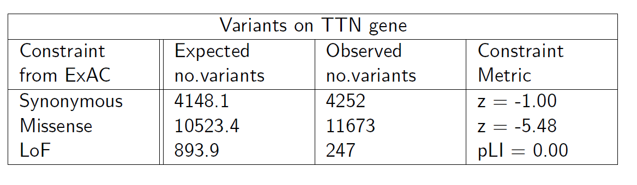
Variants on TTN Gene

Slide 26
Calculating Observed and Expected Homozygosities for TTN
Expected: based on data pulled from ExAC.
Observed: based on identified Het/Hom counts from ALS dataset
Apply Score Test on TTN gene.
Notes:
1 Calculate expected compound homozygous probability for TTN gene, based on allele frequence data pulled from ExAC website.
2 Calculate observed compound homozygous probability for TTN gene, based on identied Heterozygous counts and Homozygous counts
from ALS dataset.

Slide 27
Test Loss of Homozygosity on TTN
The expected homozygosity is 1.97E-4.
From the ALS data, extract the observed homozygosity vector.
Apply Score Test: P-value = 7.07E-08
Reject the Null hypothesis for TTN gene at this point.
https://github.com/breezedu/LossHomozygosity/blob/master/RSimulation/chi_test_of_TTN_gene.R
Notes:
Apply Score Test, the Pai_2|g of TTN gene is 3.63E-5, this is the expected probability of homozygosity/compound heterozygosity rate.
P-value ( 1 - pchisq(27.702, 1)) / 2, we got very signicant P-value = 7.07E-08
So we could reject the Null hypothesis for TTN gene at this point.

Slide 28
Fisher Information
From the likelihood function:
Take derivative of the log-likelihood for twice
Notes:
Challenge: Some genes do not have sufficient mutations. Var(Si) = 0;
Fisher Information will give a new variance, based on the parameters by minus expectation of 2nd derivative log-likelihood:
This is the new variance we will use in the new score test of which the score will follow Chi-square distribution with 1 degree of freedom.
In Statistics, the Fisher information is a way of measuring the amount of information that an observable random variable X carries about an unknown parameter , of a distribution that models X.
In our study, it's the variance of the expected value of the observed information. It will give a new variance, based on the parameters.

Slide 29

Monte Carlo Simulation
In the update Score Test:
Extremely computationally intensive to calculate the ρ_{gi}*(π_{2|gi})²
We have to use MC to simulate the $π$ based on the distribution of alleles along a gene.
Notes:
Take TTN gene for example, there are 400+ qualified alleles along the gene,
for each site there are 3 categories, 0, 1, and 2, thus for this single gene we would expect 3^400 genotypes,
it is not possible to calculate all these probabilities, so we have to use Monte Carlo Integration to simulate the out comes.
So far so good.

Slide 30
Aim #2
Admixtrure Mapping SNP Population Data to Evaluate Genetic Susceptibility to Staphylococcus. aures
Notes:
combining SNP and admixture association in case-control studies, as well as methods for local ancestry-aware imputation.
Their methods and our publicly available software are broadly applicable to GWAS in admixed populations.
ADMIXTURE's estimate individual ancestry fractions Q and population allele frequencies F
It is ideal we do not know the contributing ancestral populations.

Slide 31
Background and Motivation
Staphylococcus aureus infections:
A leading cause of disease in humans.
Genetic variations and susceptibility:
African-American > European-descended populations
GWAS:
Genetic heterogeneity and structure of African-American
Admixture Mapping:
Evaluate role of African-American genetics in S.aureus.
Notes:
Admixture Mapping: a unique strategy to evaluate role of AA genetics in S.aureus.
ADMIXTURE is a software tool for maximum likelihood estimation of individual ancestries from multilocus SNP genotype datasets. It uses the same statistical model as STRUCTURE but calculates estimates much more rapidly using a fast numerical optimization algorithm.
Specifically, ADMIXTURE uses a block relaxation approach to alternately update allele frequency and ancestry fraction parameters. Each block update is handled by solving a large number of independent convex optimization problems, which are tackled using a fast sequential quadratic programming algorithm. Convergence of the algorithm is accelerated using a novel quasi-Newton acceleration method. The algorithm outperforms EM algorithms and MCMC sampling methods by a wide margin.

Slide 32
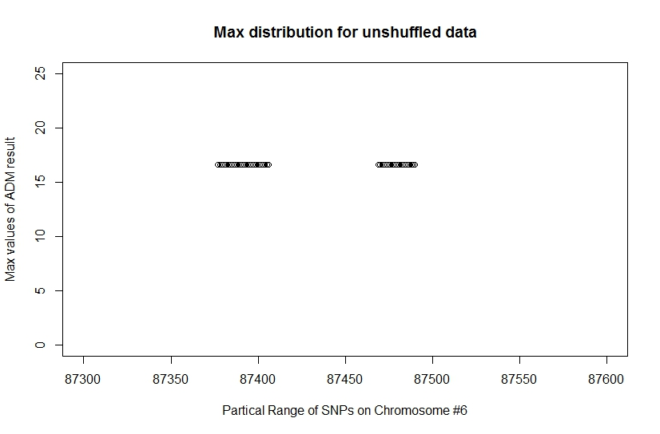
Differential Admixture on Chromosome #6
Notes:
In the joint project of Dr. Allen and DCRI, we find there is a region on chromosome 6 which provides suggestive evidence of differential admixture.
Physical location: chromosome #6, base pair 32377284-32660943;

Slide 33
Methods
Case-Control design
565 adults: 390 cases, 175 controls
MixScore software
To evaluate association statistics on the admixed data
Hypothesis
The MixScore would follow normal distribution
Permutation shuffling
Circled SNP-blocks data structure shuffling
PLoS Genet 7(4): e1001371. doi:10.1371/journal.pgen.1001371
Notes:
The mixscore software was a joint project developed by 38 institutes.
MIXSCORE is a method for combining SNP association and admixture association statistics to increase power in GWAS in admixed populations
ADM compares local ancestry in the disease cases to the average local ancestry across the genome in the same cases.
According to the paper, it is more powerful than comparing between cases-controls;

Slide 34
Protocol
Build SNP-blocks (00, 01, 11)
Shuffle, re-align
Call MixScore to perform ADM analysis
Merge outputs into one matrix
Extract maxs from each ADM result
Notes:
The shuffling would use 4-cpus and 32 G RAM
The ADM analysis used up to 20,000 CPUs and 160k Gigabyte RAM, took the cluster about one week;
Others could be processed on local desktops;

Slide 35
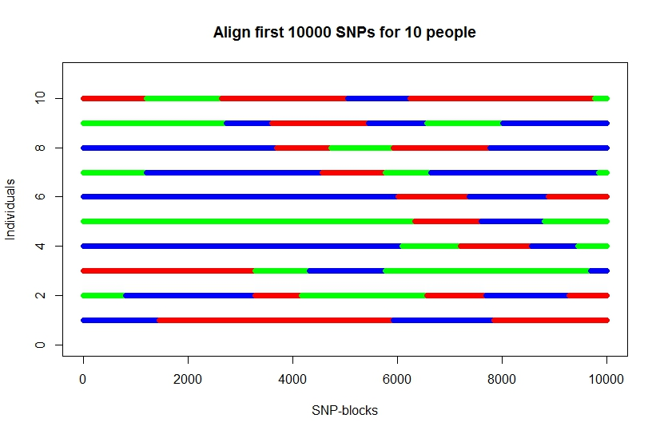
Shuffle-align-mixscore
Notes:
This figure shows how to align the SNP blocks;
Although all individuals share the same number of SNPs alone each chromosome, there are different number of blocks.
As shown here, there are 10 person and 10,k SNPs.
We shuffle the blocks, and re-align then pass the shuffled data to MixScore to perform ADM analysis.

Slide 36
Circle Shuffle
Notes:
To avoid the gathering of type 2 SNP blocks in the first and the last blocks.
We created a circled data structure. Link the last block to the head black. Formed 565 circles from 565 individuals.
Then stack 565 circles together.
Re-open the circles, we will get a new matrix, and pass this to the mixscore.

Slide 37
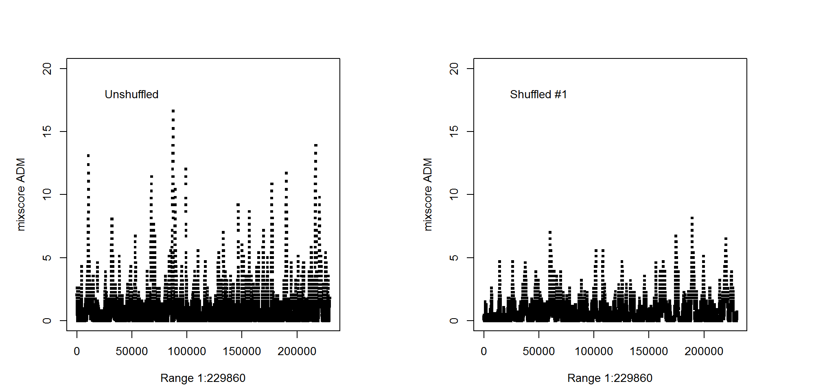
Admixtrure Mapping Genetic Data to Evaluate Susceptibility To S. Auras
Notes:
Compare the ADM mixscore analysis result between unshuffled and shuffled datasets;
The maximum value and the variances in the shuffled result are lower.
ADMIXTURE is a software tool for maximum likelihood estimation of individual ancestries from multilocus SNP genotype datasets. It uses the same statistical model as STRUCTURE but calculates estimates much more rapidly using a fast numerical optimization algorithm.

Slide 38
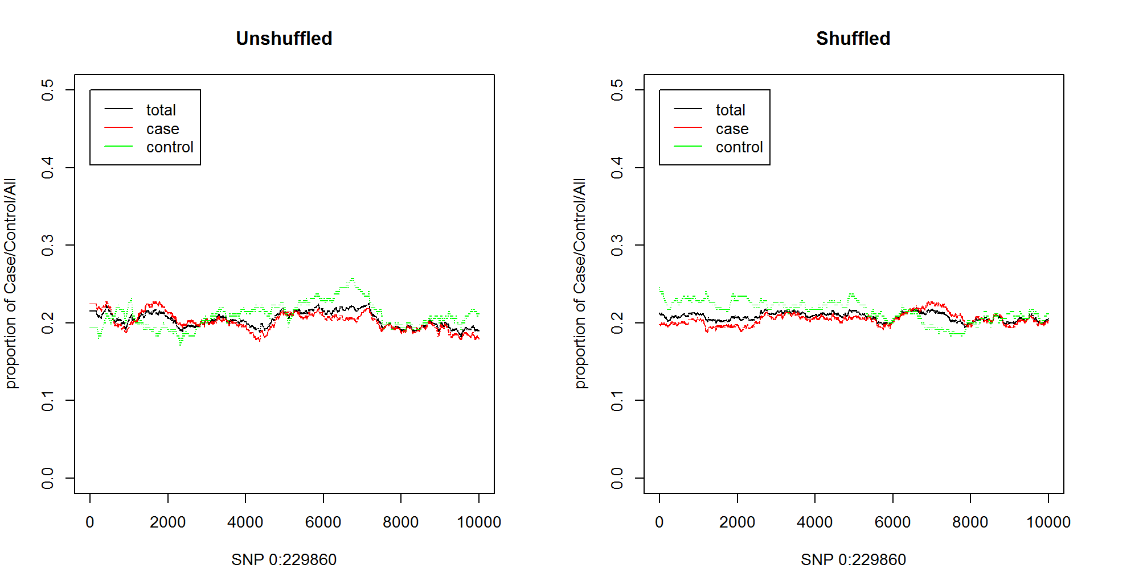
Proportion of European Ancestry
Notes:
X- axis: Physical Position In Genome (Bp)
Y-axis: proportion of European ancestry on each SNP site;

Slide 39
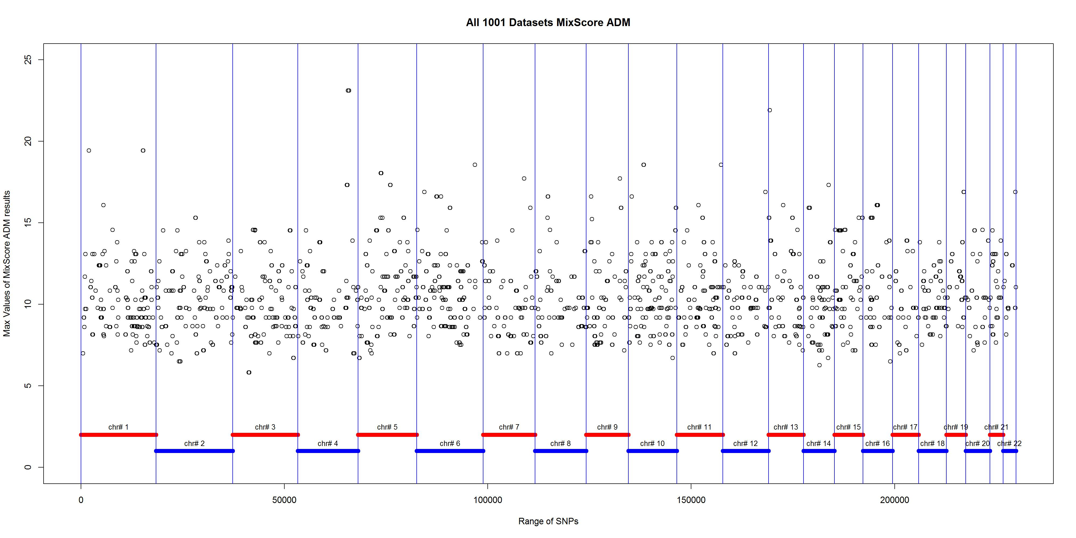
Physical Position of 1st greatest ADM values
Notes:
The physical positions of those maximum values follow unique distribution, alone 22 chromosomes.
Also, the max could happen on the boundaries of chromosomes.

Slide 40
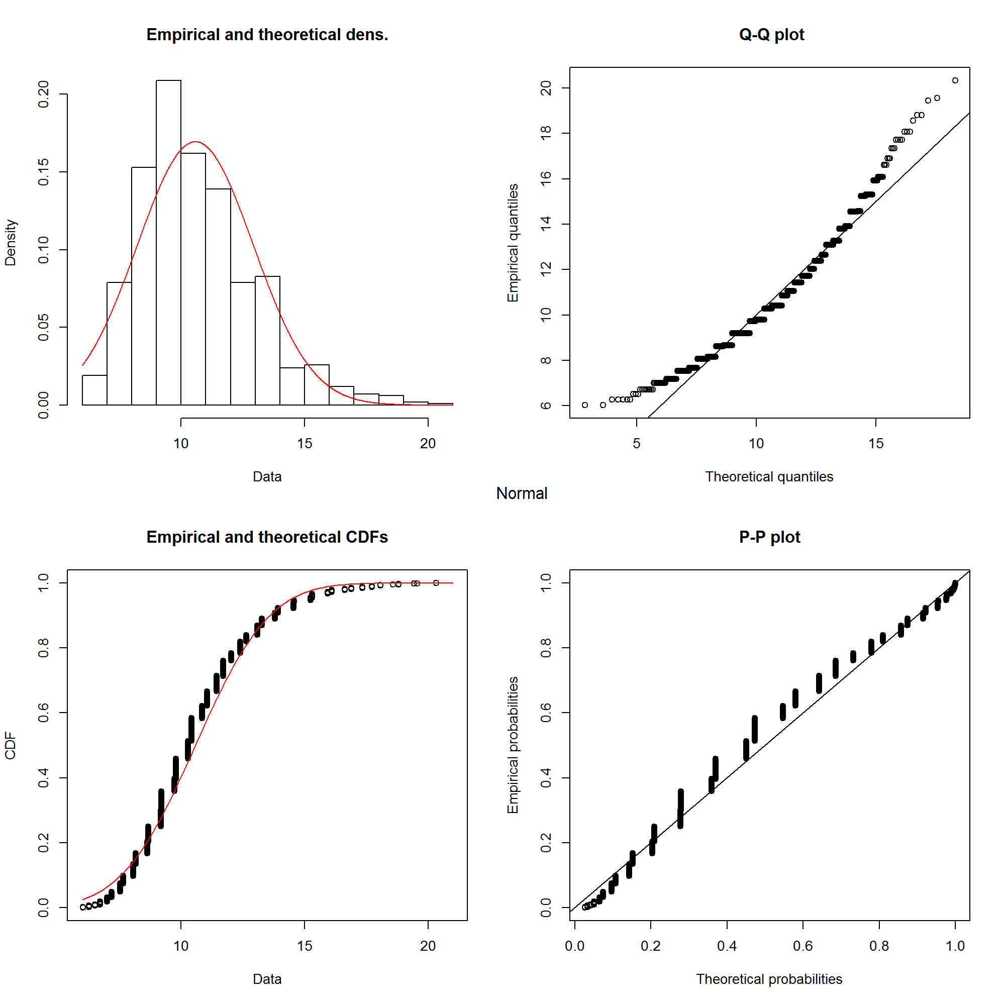
Density Distribution of 1st greatest values
16.4 unshuffled
Notes:
The density of these maximum values follow normal distribution.
The maximum ADM value from unshuffled dataset is 16.4, on the right tail of the distribution.

Slide 41
Step-down MinP Adjusted P-values
1st maximum value: 0.0179
2nd maximum value: 0.0286
3rd maximum value: 0.0455
4th maximum value: 0.0532
5th maximum value: 0.0773
Y Ge, T Speed, 2003, #633 TechReport Resampling-based multiple testing for microarray data analysis
Notes:
Here I listed the percentage of maximum values of unshuffled data to the whole 10,000 shuffled datasets.
The p-value for 1st max is 0.0179. This also mean of all 10k shuffled datasets, only 179 of them have max values greater than max value of unshuffled data.
P-value For The First 5 Maxs

Slide 42
Aim #3 Future Work
Recessive intolerance in non-coding sequence.
Recessive intolerance in sub-regional sequence.
More data will be available from ExAC and gnomAD

Slide 43
Thank you!

Slide 44
Appendix

Slide 45
Model Inferring Score Test
A test could then be formed:
Notes:
Taking the log of the last equation, differentiating with respect to beta, and evaluating under the null hypothesis beta = 1 gives our score: Si
Under the null, we would expect T to follow an chi-square distribution asymptotically.
In order to carry out any of these calculations, we need to characterize Pai_2|g and Rho_g.
In our model, we assume that the variants are in approximate linkage equilibrium and any given mutation is equally likely to fall on any given haplotype.

Slide 46
Fisher Information
Take derivative of the log-likelihood for twice
Notes:
After taking derivative twice, we would get information function;
Under Null hypothesis, H0 : Beta = 1;
We also have Pai-0g + Pai-1g + Pai-2g = 1,

Slide 47
Fisher Information
Notes:
Fisher Information will give a new variance, based on the parameters by minus expectation of 2nd derivative log-likelihood:
This is the new variance we will use in the new score test of which the score will follow Chi-square distribution with 1 degree of freedom.
The score will follow Chi-square distribution with 1 degree of freedom.

Slide 48
Monte Carlo simulation
1 we simulated Pai_2|g for genes with less than 20 variants
2 simulate Pai_2|g for TTN gene, get very close results

Slide 49
Mixscore ATT

Slide 50
Mixscore snp1

Slide 51
Mixscore snp1

Slide 52
Mixscore snp1

Slide 53
Mixscore adm

Slide 54
Let hi be the genome-wide ancestry of individual i, and let Ni be the
number of European chromosomes in individual i at the candidate SNP. Restricting to disease cases only, we define the likelihood as
function of ancestry odds ratio Omega, where Omega is the multiplicative risk
for disease given one or two European alleles. It follows that the
likelihood for 2, 1, or 0 European alleles at individual i is:

Slide 55
Notes:
A χ²(1dof) likelihood ratio test that compares the local ancestry in the disease cases to the average local ancestry across the genome in the same disease cases.
Let θ_{i} be the genome-wide ancestry of individual i, and
let N_{i} be the number of European chromosomes in individual i at the candidate SNP.
the likelihood as function of ancestry odds ratio Ω, where Ω is the multiplicative risk for disease given one or two European alleles.
Then the likelihood is , with the a χ²(1dof) likelihood ratio test defined as:

Slide 56
Association Statistics for Case-control Phenotypes
Notes:
A χ²(1dof) likelihood ratio test that compares the local ancestry in the disease cases to the average local ancestry across the genome in the same disease cases.
Let θ_{i} be the genome-wide ancestry of individual i, and
let N_{i} be the number of European chromosomes in individual i at the candidate SNP.
the likelihood as function of ancestry odds ratio Ω, where Ω is the multiplicative risk for disease given one or two European alleles.
Then the likelihood is , with the a χ²(1dof) likelihood ratio test defined as:

